Slide 1


Final Year Project Proposal
Mudabbir – Facilitating Subject Specific Study of Quran-ul-Hakeem
Supervised By: Dr Muhammad Sajid Qureshi
Assistant Professor

Slide 2
Project Team
Zain Ali – 57113
Ehtisham Hussain – 56305
Waleed Ahmad – 56336

Slide 3
Contents
Introduction and Background
Benchmarking and Summary Table
Gap Analysis
Problem Statement
Proposed Solution & Methodology
Project Scope
Constraints & Limitations
Work Breakdown / Roles

Slide 4
Introduction &
Background

Slide 5
Introduction & Background
Mudabbir is an intended AI-powered software platform for subject-specific study of Quran-ul-Hakeem.
It shall provide the following facilities:
  Facilitation in subject specific learning of Quran-il-Hakeem.
  Relevance of verses with a subject.
  Subject specific search facility.
  GenAI based summarization of Quranic subjects.
  Learning assessment facility of a Quranic subject.
  Micro-credential courses of Quran-il-Hakeem.
  AI-assistance for content generation (Khutba, Daroos ).

Slide 6
Benchmarking

Slide 7
Benchmarking – Islam 360
Islam 360
  Provides information like:
    Quran with Translation
    Audio Tafseer
    Quran recite learning
    Word by word Ayat translation
    Keyword / Topic Search

Slide 8
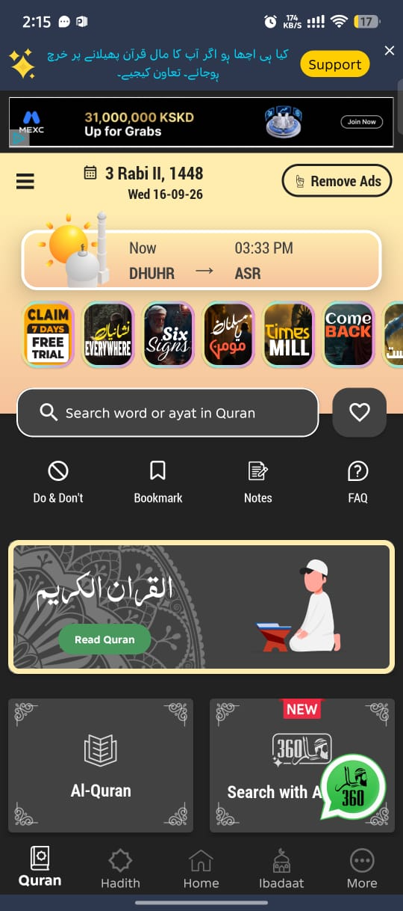
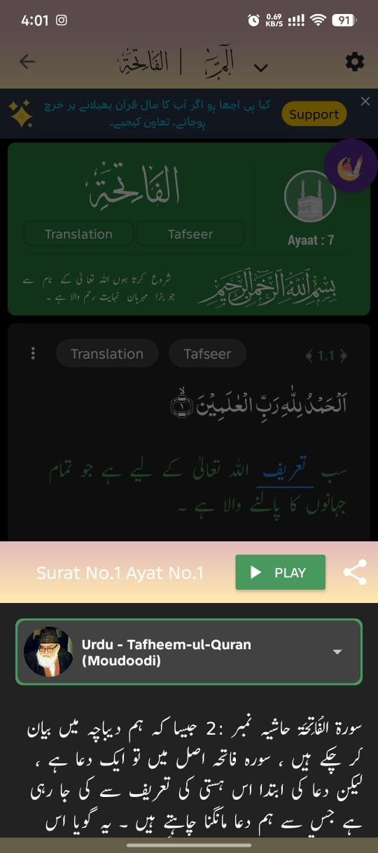
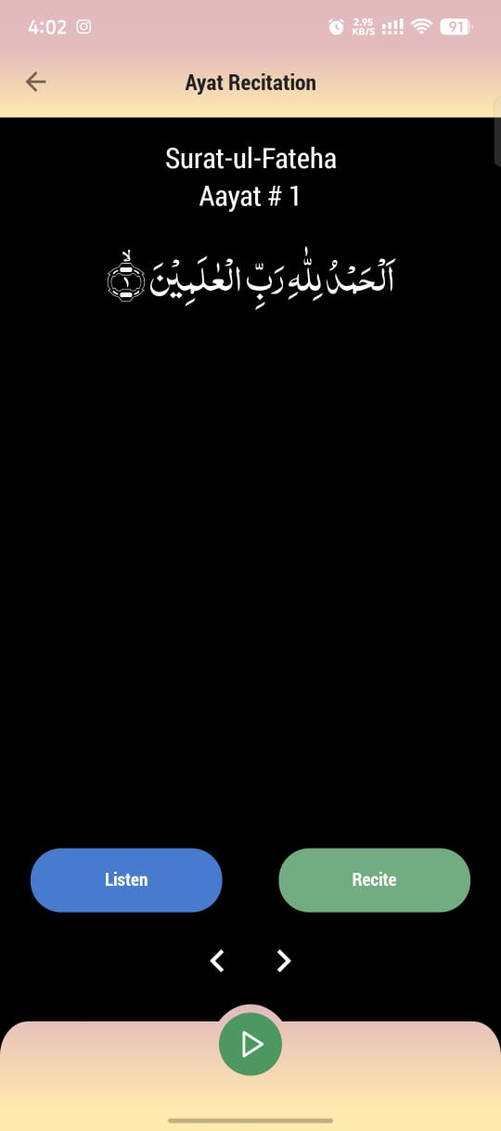
Benchmarking – Islam 360
Islam 360

Slide 9
Benchmarking – Islam 360
Islam 360
  However, it does not provide:
    Verses relevance with subject
    AI generated summary of subject
    Assessment of learning of subjects
    Micro-Credential Courses
    Compilation of Duroos and Khutbaat using Gen AI

Slide 10
Benchmarking – Muslim Pro
Muslim Pro
  Provides information like:
    Quran with Translation
    Salah Streak Tracker
    Mosque Finder
    Islamic Feed / Reels (Ummah)

Slide 11
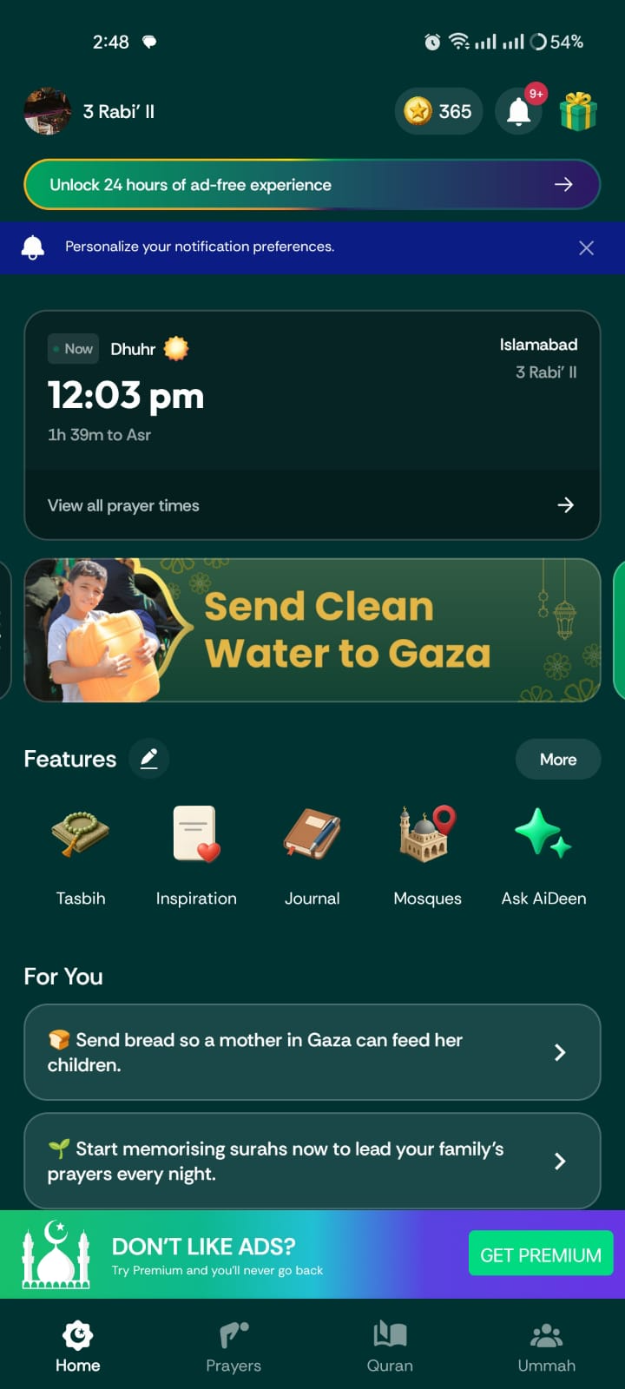
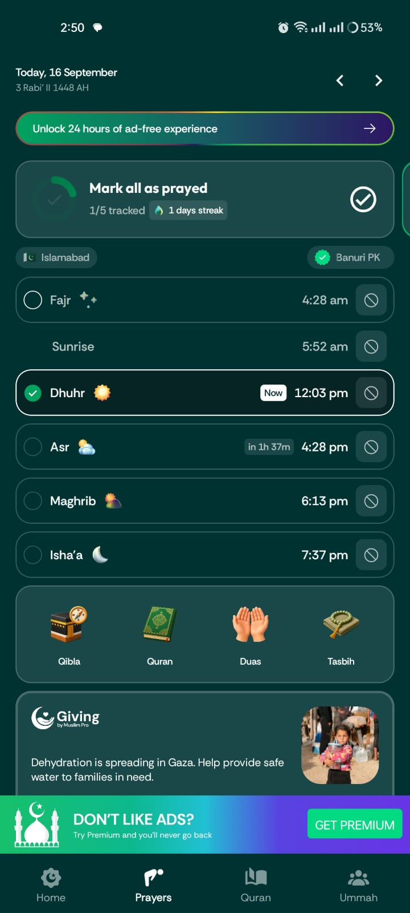
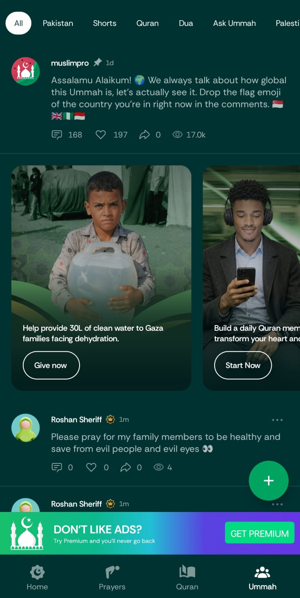
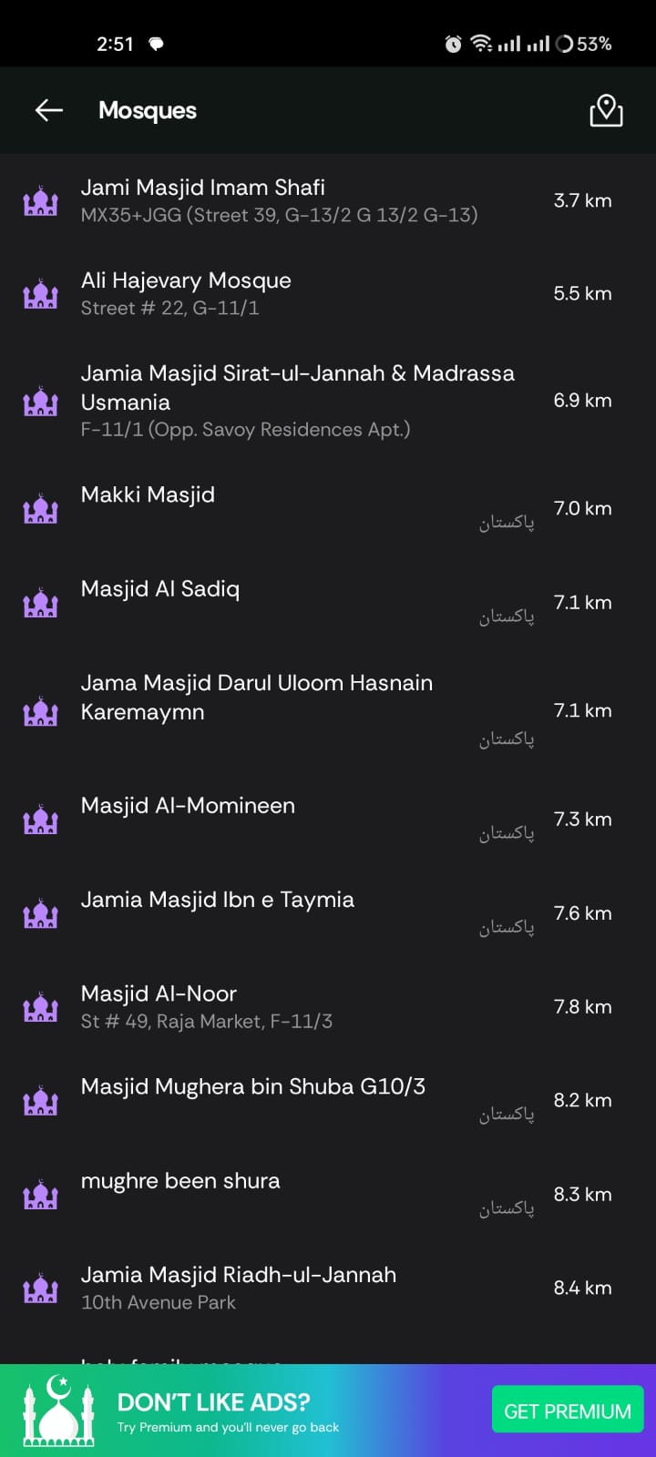
Benchmarking – Muslim Pro
Muslim Pro

Slide 12
Benchmarking – Muslim Pro
Muslim Pro
  However, it does not provide:
    Verses relevance with subject
    AI generated summary of subject
    Assessment of learning of subjects
    Micro-Credential Courses
    Compilation of Duroos and Khutbaat using Gen AI

Slide 13
Benchmarking – Al Quran
Al Quran
  Provides information like:
    Quran with Translation
    Quick links of most recite surahs
    Planners
      Quran in a Month, 4 Months, Year
      Understand the Juz 30
    Quran Recite Stats and Streak

Slide 14
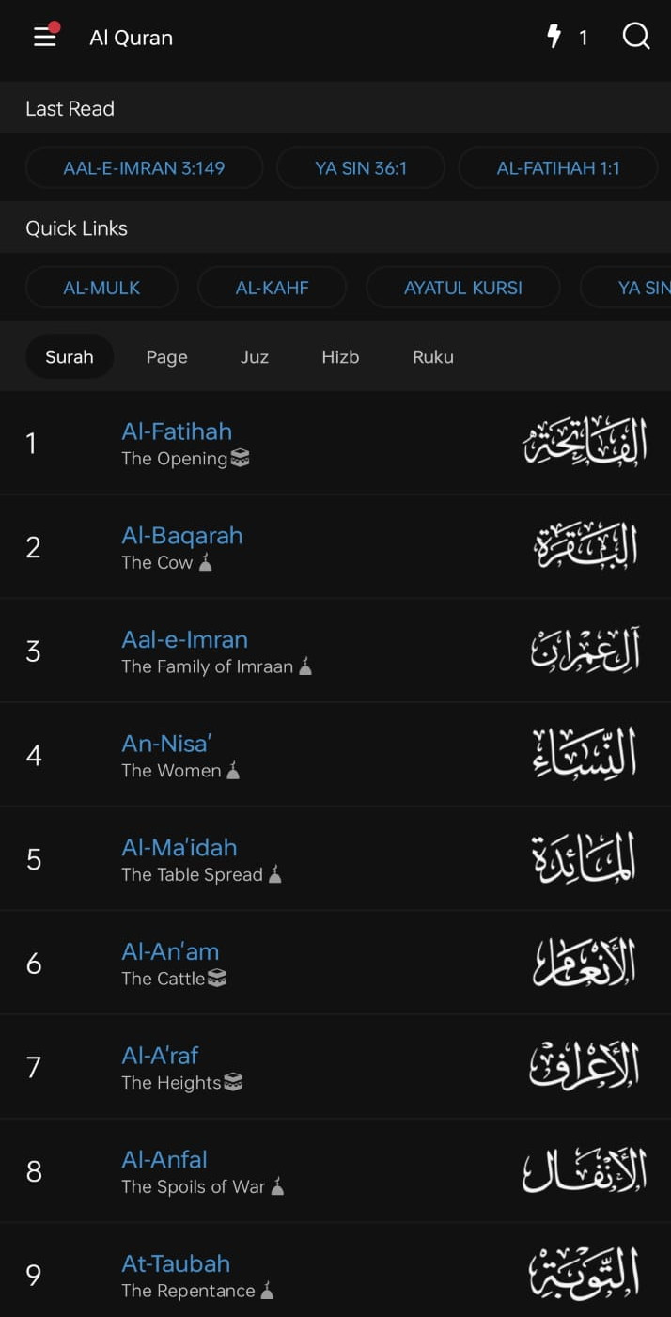
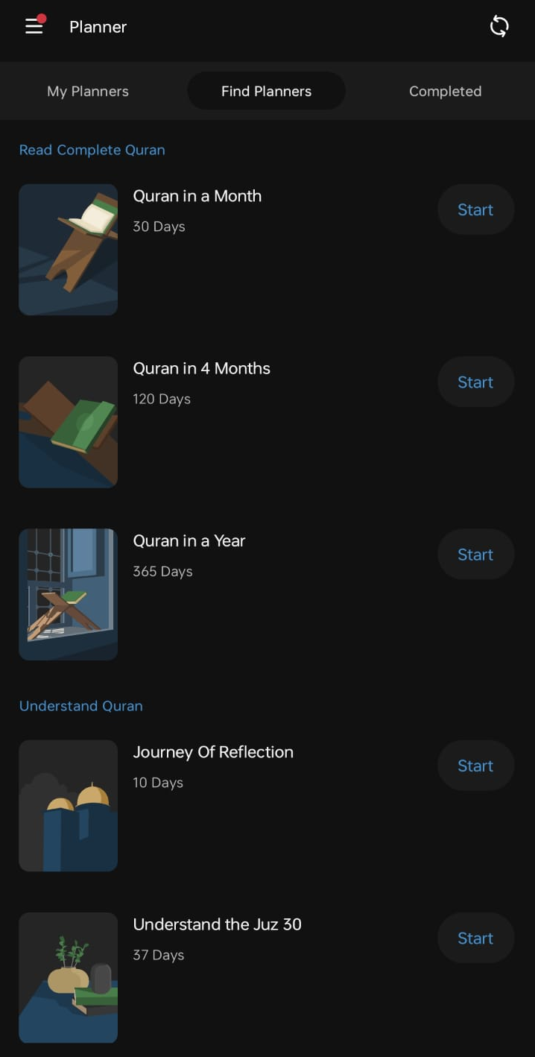
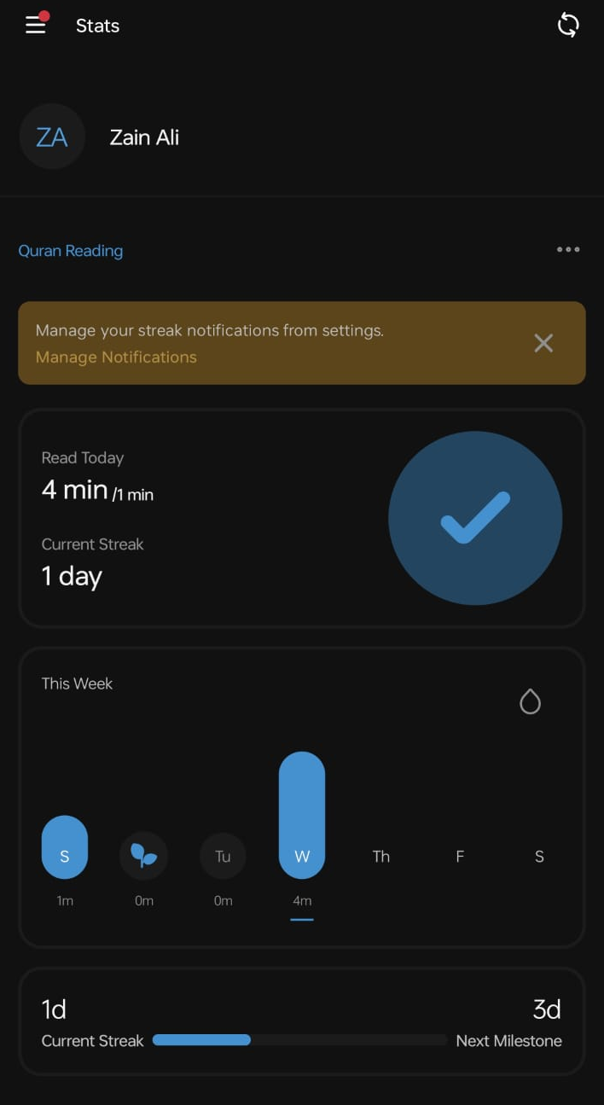
Benchmarking – Al Quran
Al Quran

Slide 15
Benchmarking – Al Quran
Al Quran
  However, it does not provide:
    Verses relevance with subject
    AI generated summary of subject
    Assessment of learning of subjects
    Micro-Credential Courses
    Compilation of Duroos and Khutbaat using Gen AI

Slide 16
Benchmarking – Summary Table
Features | Islam 360 | Muslim Pro | Al Quran | Mudabbir
Quran with Translation | ✓ | ✓ | ✓ | ✓
Keyword / Topic Search (Voice-Enabled) | ✓ | ✓ | ✓ | ✓
Audio Tafseer Lectures | ✓ | ✓ | ✓ | ✓
Word by Word Quran Translation | ✓ | ✗ | ✓ | ✓
AI Specific Topic Searching | ✗ | ✗ | ✓ | ✓
Verses relevance with the subjects | ✗ | ✗ | ✗ | ✓
AI Generated Summary of subjects | ✗ | ✗ | ✗ | ✓
Assessment of the learning of subjects | ✗ | ✗ | ✗ | ✓
Micro Credential Courses | ✗ | ✗ | ✗ | ✓
Compilation of Duroos, & Khutbaat using GenAI | ✗ | ✗ | ✗ | ✓

Slide 17
Gap Analysis /
Problem Identification

Slide 18
Major Gaps / Limitations
Limitations of existing software applications for Learners:
  Relevance of verses with a subject is not defined.
  GenAI based summarization of Quranic subjects is unavailable.
  Absence of learning assess facility of a Quranic subject.
  Absence of micro-credential Quranic courses.
  Lack of AI-assisted tools for content generation.
  Lack of subject specific search facility

Slide 19
Problem Statement

Slide 20
Problem Statement
Currently, the learners of Quran-ul-Hakeem need the following services:
  Technological assistance in subject-specific study.
  Subject-specific search of Quranic verses
  Relevance of verses with a subject is not well-defined.
  GenAI based summarization of Quranic subjects.
  Automated learning and assessment of a Quranic subjects.
  Availability of micro-credential Quranic courses.
  AI-assisted tools for content generation.

Slide 21
Proposed Solution & Methodology

Slide 22
Proposed Solution
Development of a web-base software application along with a smartphone application to provide the following services:
  Technological assistance in subject-specific study.
  Subject-specific search of Quranic verses
  Relevance of verses with a subject.
  GenAI based summarization of Quranic subjects.
  Automated learning and assessment of a Quranic subjects.
  Availability of micro-credential Quranic courses.
  AI-assisted tools for content generation.

Slide 23
Project Scope

Slide 24
Project Scope
The intended software applications shall have the following scope:
  Subject specific learning.
    Trivial services like Qibla direction, Salah time etc. Shall not be covered.
  Relevance of verses with subject.
  Automated learning and assessment services will be primarily for the young Muslims learners.
  AI-assisted tools for content generation, shall explore only authentic content verified by scholars.

Slide 25
Constraints &
Limitations

Slide 26
Constraints & Limitations
The intended software applications shall have following limitations:
  They shall provide the learning content in two languages:
    Urdu, and English
  Verse relevance ranking requires scholar involvement.
  Initially we shall offer only 5 subject of Quran.
  Relevance of subject specific verses require scholar assistance.

Slide 27
Work Breakdown / Roles

Slide 28
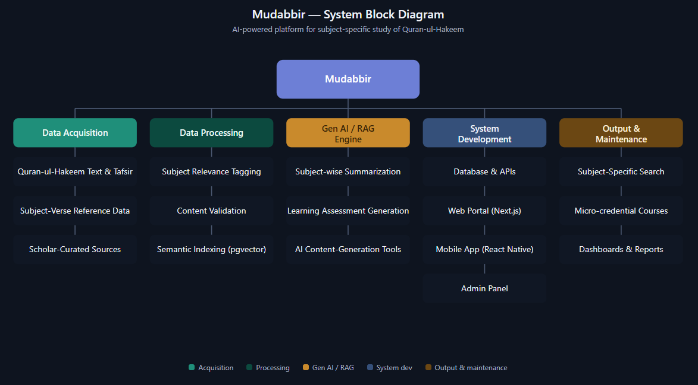
Work Breakdown Structure

Slide 29
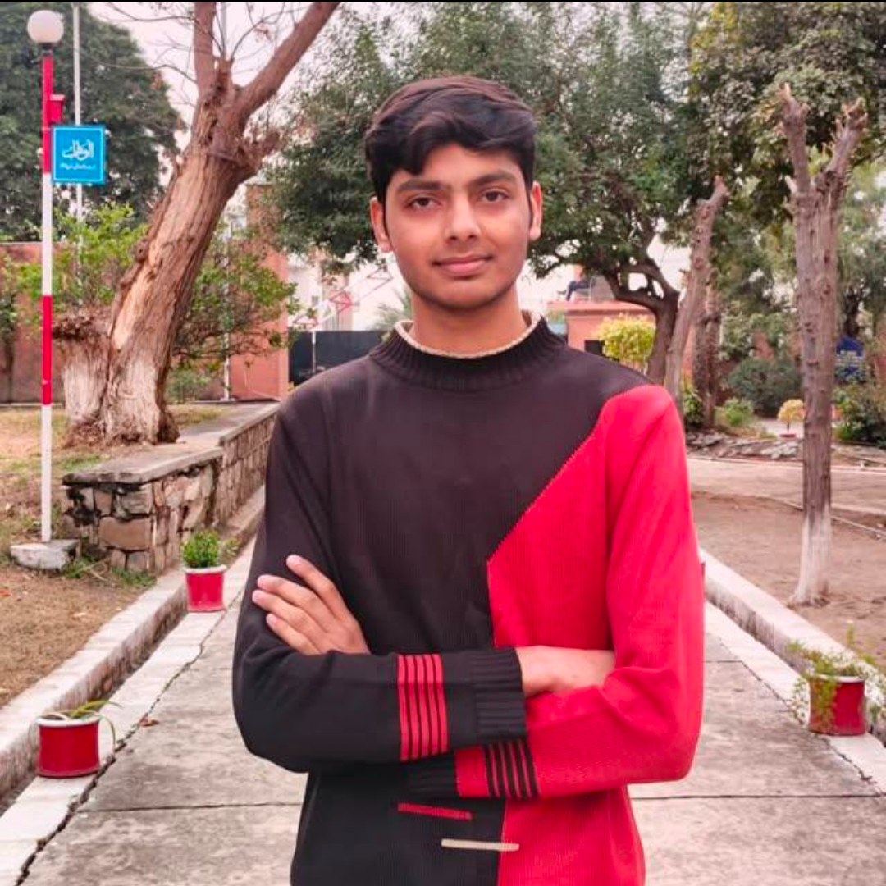
Roles
 | Zain Ali – Team Leader & Developer BS Computer Science Riphah International University, Islamabad Contact No.: +92 3266295094 Email Address: 57113@students.riphah.edu.pk Contribution(s) Team Leader of the FYP development team. Selected and responsible for the Full-Stack Web Application Development. Selected and responsible for the Web Application Integration.

Slide 30

Roles
 | Ehtisham Hussain – Developer BS Computer Science Riphah International University, Islamabad Contact No.: +92 3165366937 Email Address: 56305@students.riphah.edu.pk Contribution(s) Selected and responsible for the Application Development. Selected and responsible for the Application Integration.

Slide 31
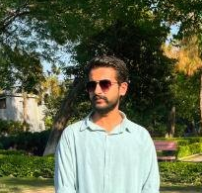
Roles
 | Waleed Ahmad – Developer BS Computer Science Riphah International University, Islamabad Contact No.: +92 3125494970 Email Address: 56336@students.riphah.edu.pk Contribution(s) Selected and responsible for the Backend and Database. Selected and responsible for the Integration of the Backend and Database.

Slide 32
Thank You
  Questions ?
  Suggestions !

